Slide 1
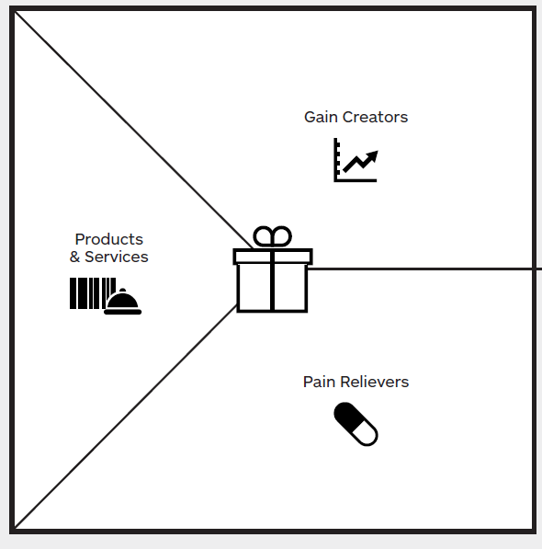
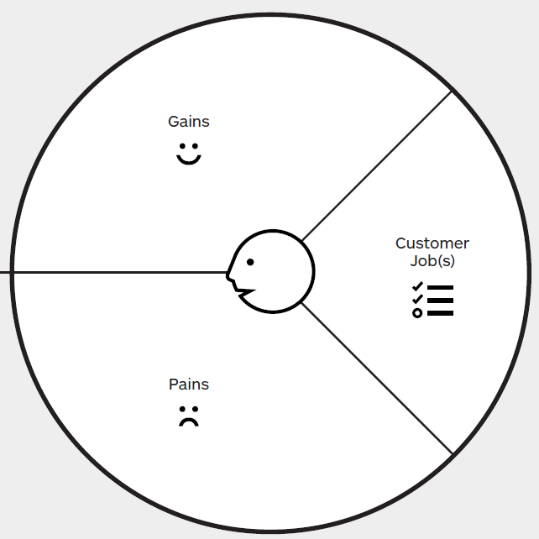
Convenient
Cheap Housing and Meals
Better Awareness of
Self & Society Mutual Acceptance
Off-campus Housing Location
Airport Pickup
Car Rental
Off-campus Housing Roommate Search
Gain familiarity of the new environment
No/Not aware of usable resources
Housing Furniture
Isolation
Dining
International Student Community
Banking and Communications
Bad roommates
Resources sought by themselves not trustworthy
Financial Imbalance
J
Overcharged Housing etc.
Shocked by cultural environment

Slide 2







The Business Model Canvas

